Slide 1

Introductions & expectations for lab attire, notebooks, and safety
Pants, no open-toe shoes, goggles unless otherwise indicated
Composition notebook
Laptop

Slide 2
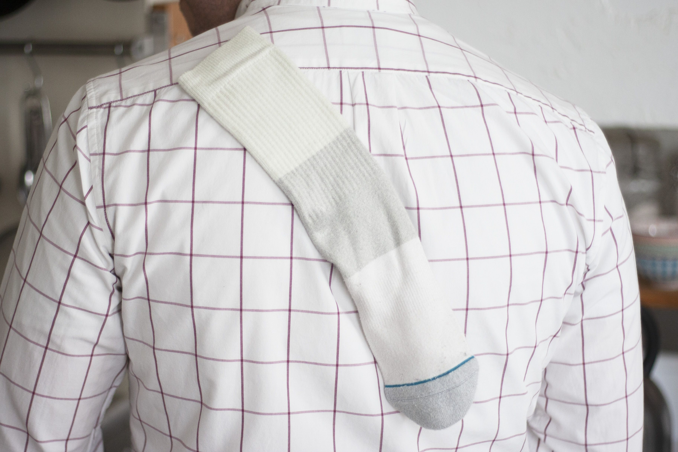
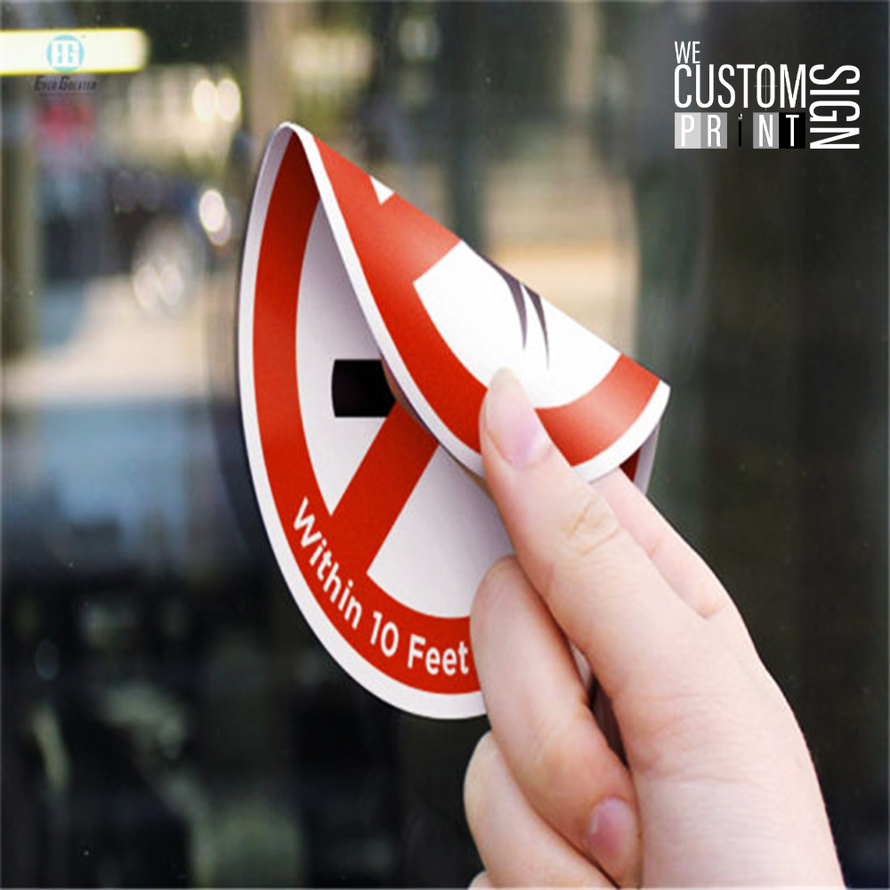
The concept of stickiness: the binding energy

Slide 3
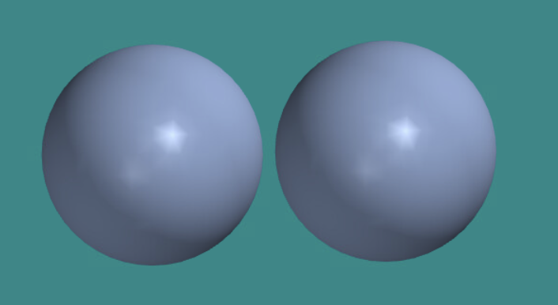
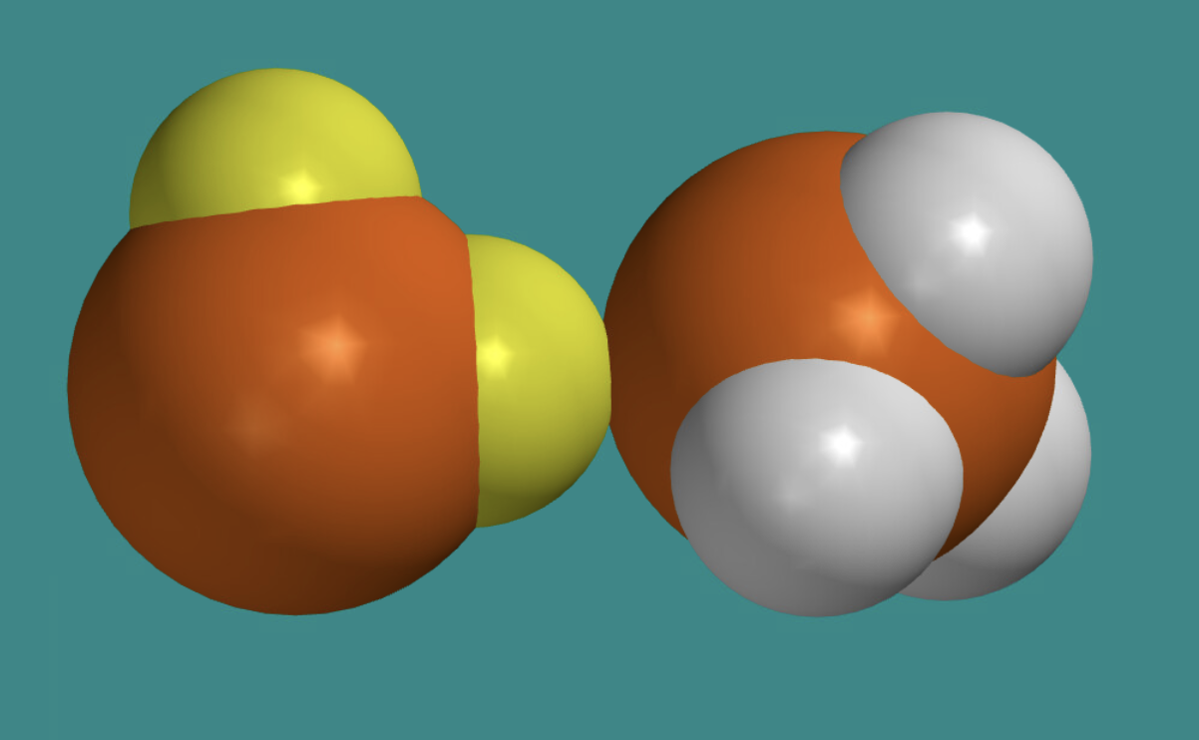
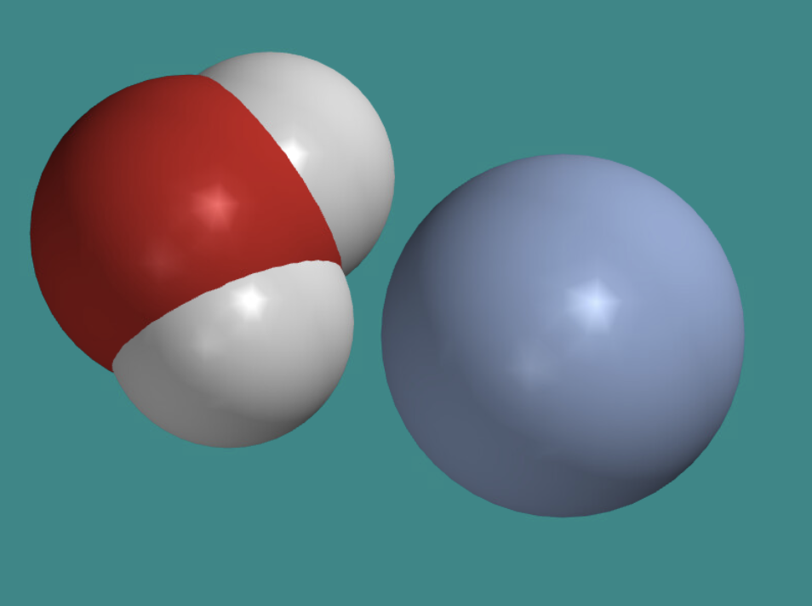
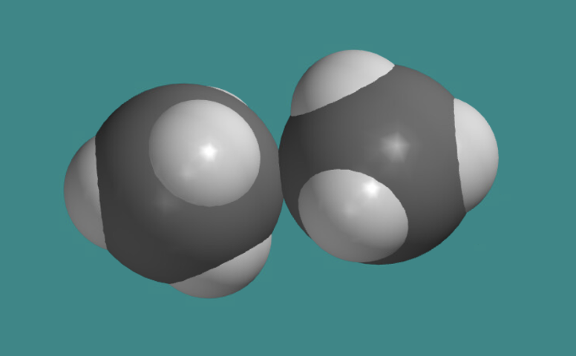
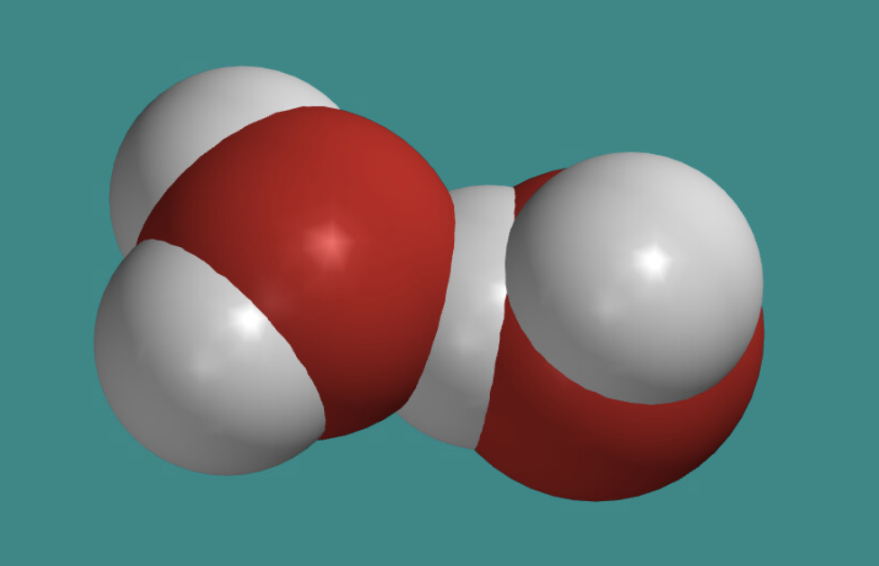
The concept of stickiness: the binding energy
Ar --- Ar
PH₃ --- PH₃
H₂O --- Ar
CH₄ --- CH₄
H₂O --- H₂O
http://vdesk.pugetsound.edu … navigate to Spartan
Watch these videos on how to measure atomic distances in Spartan, and how to find the strength of interactions between atoms

Slide 4
Preparing a presentation
Ar --- Ar
PH₃ --- PH₃
H₂O --- Ar
CH₄ --- CH₄
H₂O --- H₂O
Create a google slides document, do some screen captures from Spartan, tell your story.

